Slide 1
Developing operational climate services: education and training at WMO-RTC Italy
WMO Regional Training Center Italy | CNR IBE, Italy
Marina Baldi, Maurizio Bacci, Vieri Tarchiani, Elena Rapisardi, Massimiliano Pasqui, Francesco Sabatini

Slide 2
The WMO Regional Training Center in Italy
The WMO Regional Training Centre Italy of the World Meteorological Organization (WMO) is an integral part of the RTCs global network and it is managed and operated by the CNR - Institute of BioEconomy.
A 36-year-long history
1987
1997
2004
2016
2019
2022
MoU
The Institute of Bioeconomy of the National Research Council of Italy (CNR-IBE) has been operating as the World Meteorological Organization's Regional Training Centre Italy (RTC Italy) since 1987.
The RTC Italy was officially confirmed in 1997.
The RTC received reconfirmation from the WMO Executive Council in both 2004, 2016 and 2022 (WMO EC-76/Doc. 3.4(3))
In 2019 was signed a new MoU between WMO, PR of Italy with WMO, and CNR-IBE.
Notes:
The 36 years long history of the RTC can be found in few papers recently published
L’istituto di Bometeorlogia e il centro regional di formazione del WMO in Italia (Rivista Meteorlogia Aeronautica)
North –South cooperation to prevent natural disasters (WMO website)
https://wmo.int/media/news/wmo-regional-training-centre-italy-supports-competency-development-climate-services-africa (WMO, 70° annuversary)
Contribution in https://library.wmo.int/records/item/57235-global-campus-innovations?offset=10 (WMO)
Presentation at EMS Annual Meetings:
https://meetingorganizer.copernicus.org/EMS2021/EMS2021-32.html
https://asr.copernicus.org/articles/17/47/2020/

Slide 3
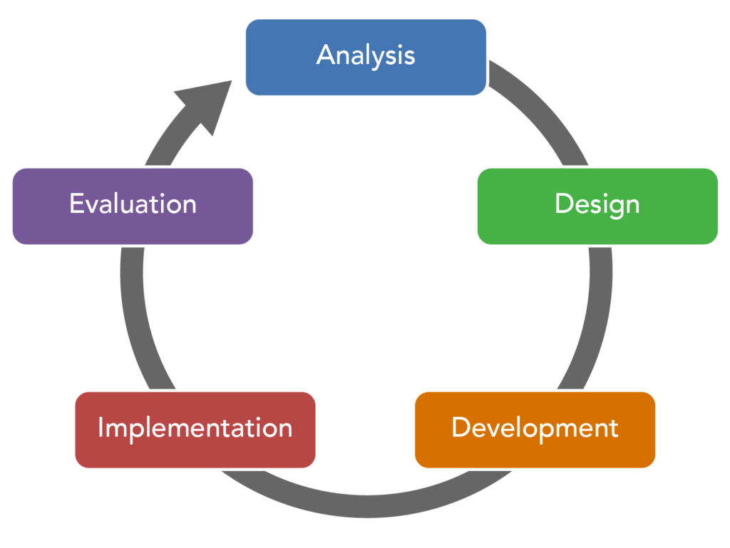
Training design and delivery: the ADDIE model
Analyze
WMO Learning Team and Training beneficiaries identify training needs and co-design training.
Design
Definition of learning goals and outcomes, training strategies and specific aims.
Develop
Definition of learning solutions and formats to meet learning goals and users’ need.
Implement
Training course, with workshop, seminars and practical sessions, online learning platform and training materials.
Evaluation
Post course participants’ survey to assess the achievement of training goals and improve training offer.
Notes:
What we offer:
Courses and workshops
Short-term training courses or workshops held in Italy and abroad, and long-term stages (2-4 months).
Custom Designed Training
Domestic and international training activities organized on the basis of emerging training needs.
Elearning
The Center develops online training packages widely accessible and designed to build Knowledge and Skills particularly in Climate Services field.
Trainers
Highly qualified and experienced trainers: CNR scientists, faculty from other Institutions and Universities appointed on the basis of the course content.
Learning Solutions
Courses usually include
Classroom lectures in the morning
Practical sessions in the afternoon
Group discussions
Field trips
Distance Learning Module DLM offered as pre-course activity, using Moodle, with the purpose of offering to participants the basic tools and background knowledge useful for the face-to-face training.
Fully online courses since the pandemic started

Slide 4
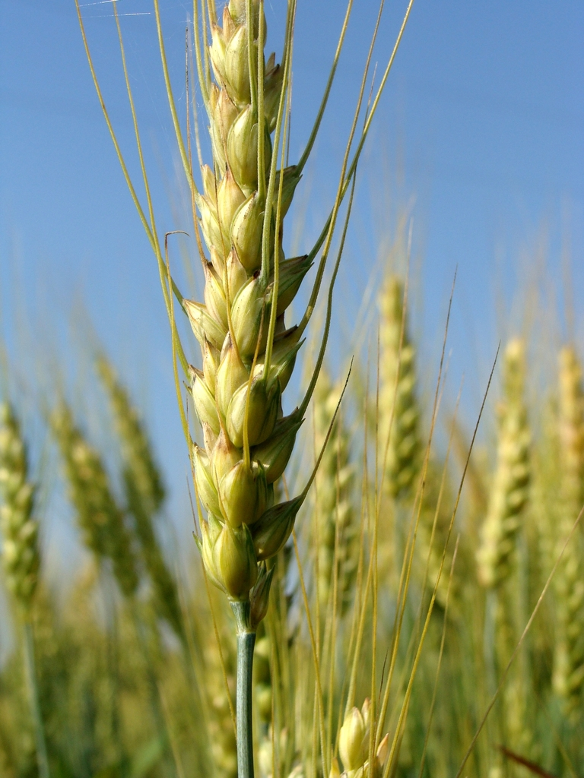
Training Topics
Agrometeorology and innovative solutions for climate services in agriculture, water and food security.
Climate Change and Climate Variability and their effects on natural resources, water and agriculture.
Sub-seasonal to seasonal forecast/predictions as a tool for water and agriculture management.
1999-2023
35
COURSES
>800
PARTICIPANTS
Trainers and collaborations
>2000
Experts from other CNR-IBE offices
Experts from other CNR Institutes
Experts from Universities (national and international)
HOURS OF LESSONS
Notes:
Core business is Agricultural meteorology, declined in different topics from agro-climatology to agro-meteorological services to precision agriculture. Climate services expands also to water and food security.
Climate change and variability, including extremes and impacts on natural resources and human societies
Seasonal to sub-seasonal forecasting is an important scientific topic we developed through several courses in the Mediterranean area and in Africa
As you see from the figures, we prefer to have a reduced number of courses and participants with higher engagement and follow-up rather than extensive training with lower relationship.
The AgroMetSchool is now at its 4th edition. In total we had about 100 trainees, 40 lecturers and facilitators/tutors, more than 120 hh lessons.

Slide 5
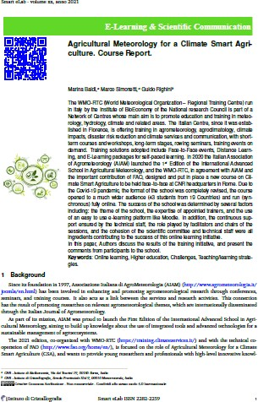
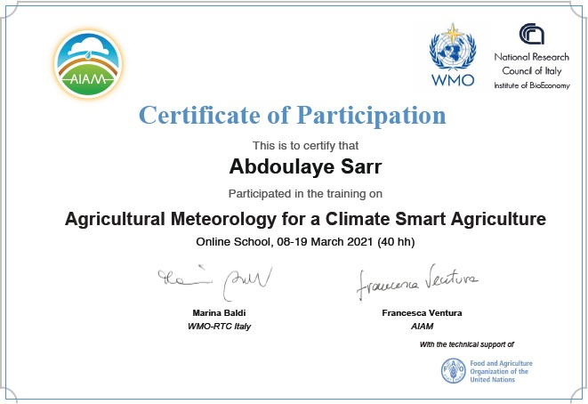
Assessing knowledge and competency of students
Badges
Certificate of attendance
Certificate of completion
Evaluating effectiveness and quality of learning services
Course evaluation questionnaire
Course final report
External assessment (PACC-RRC)
Notes:
Badges for documenting and demonstrating competencies acquired and linked to WMO competencies framework. Open to ensure re-usability of badges in other environments (Mozilla Badgr)

Slide 6
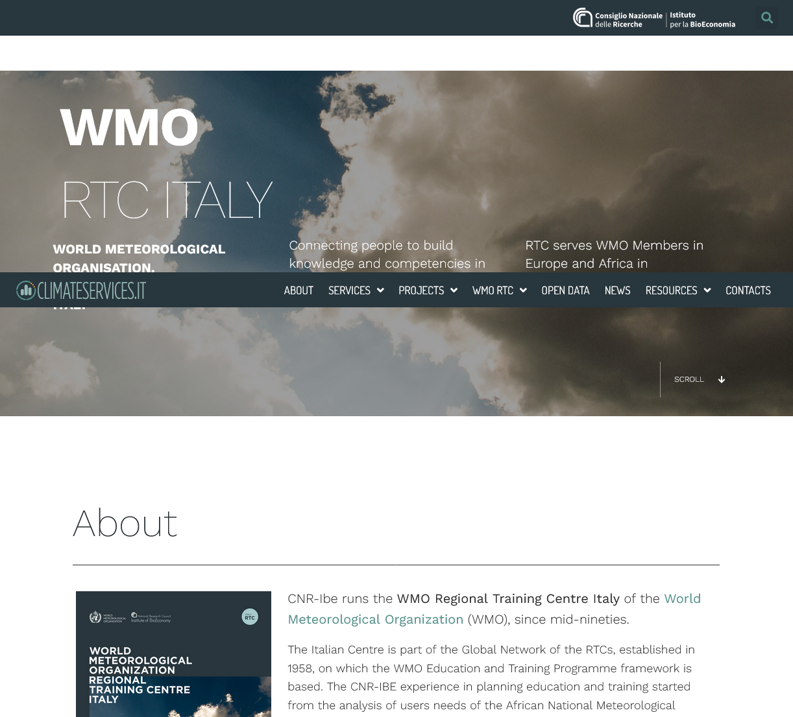
Get Connected
Marina Baldi
Consiglio Nazionale delle Ricerche Istituto per la BioEconomia
CNR-IBE, Roma - I
wmortc.italy@gmail.com
https://climateservices.it/ https://climateservices.it/rtc-italy/

