Slide 1
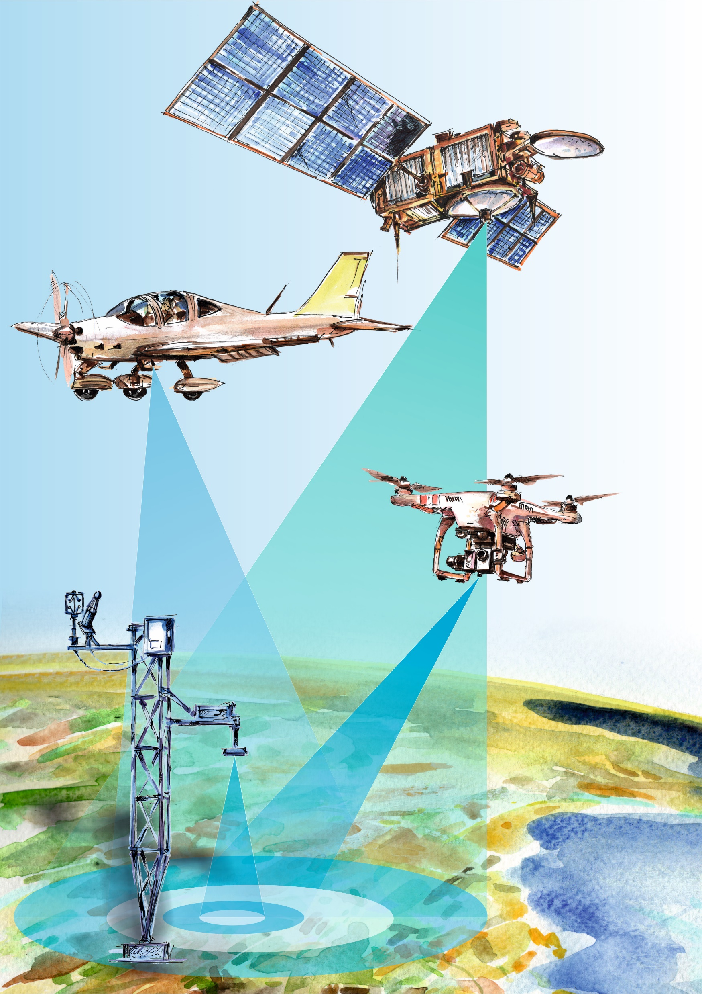
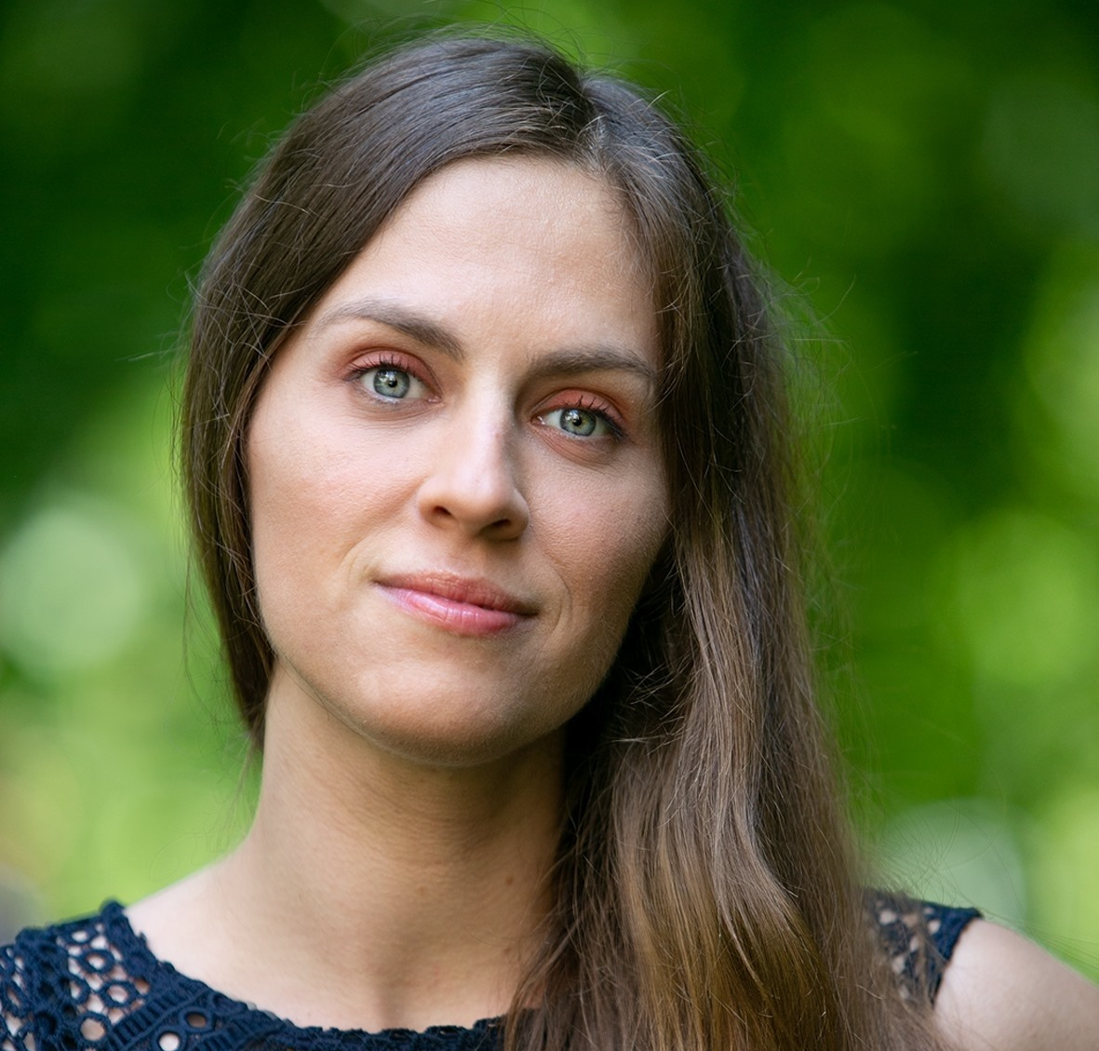
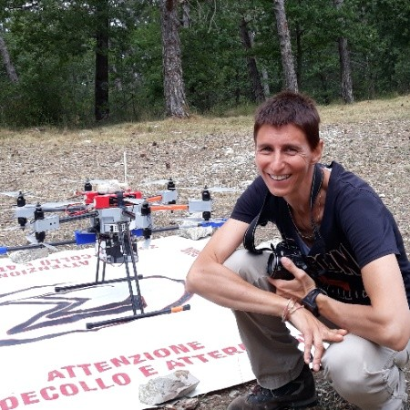
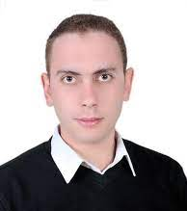


CNR-IBE SMA: Ecophysiological Remote Sensing
Karolina Sakowska
Researcher
Chiara Torresan
Researcher
Mustafa Elfahl
ADR PostDoc
ADR Senior
RTD

Slide 2
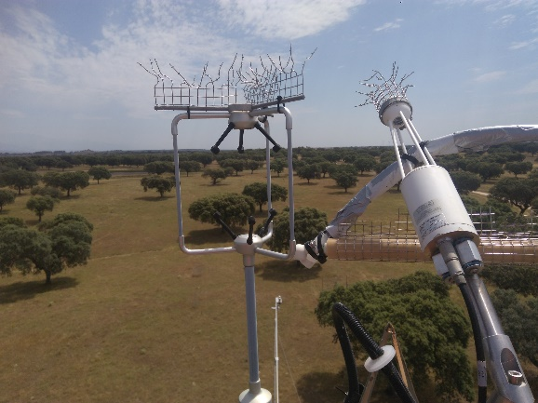
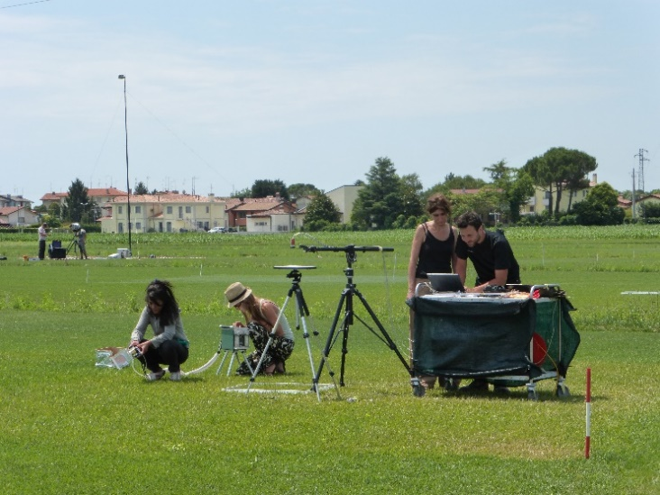
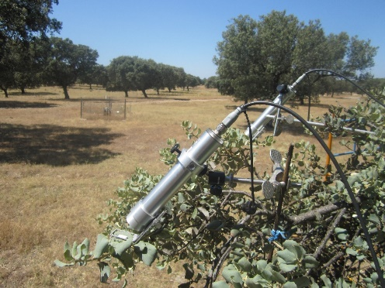
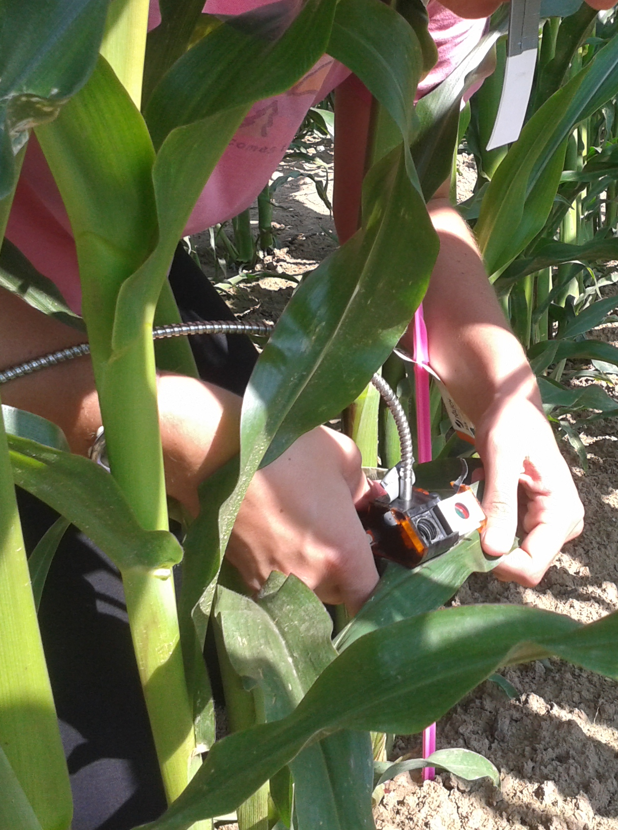
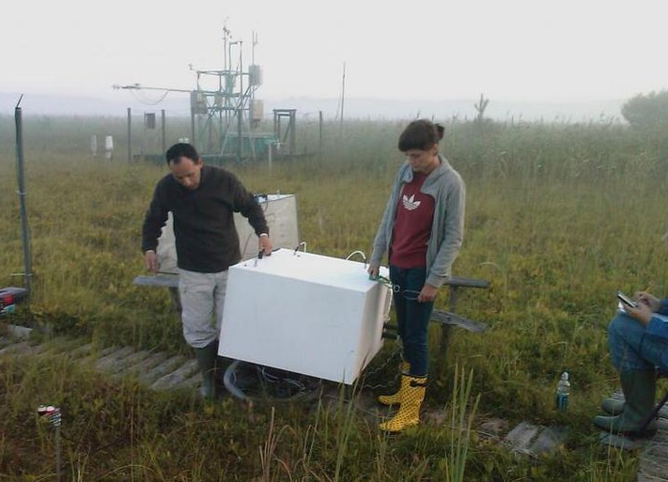
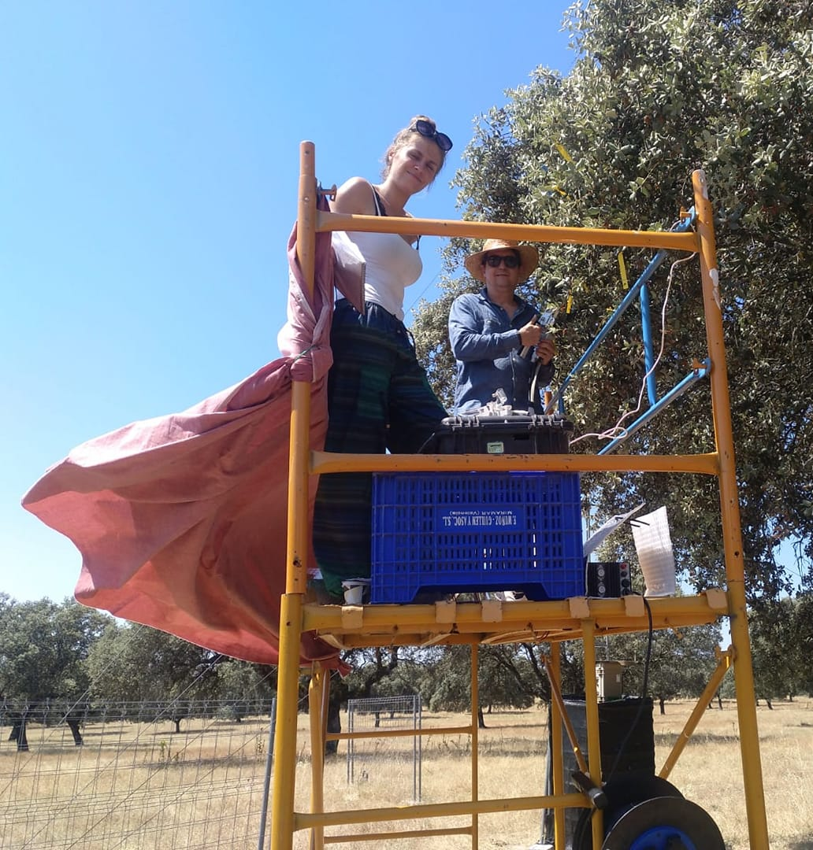
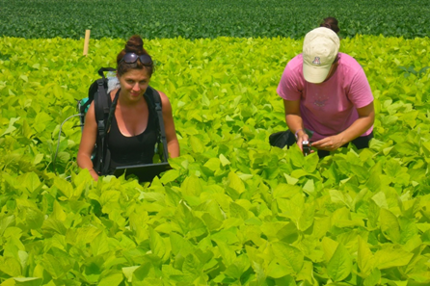
CNR-IBE SMA: Ecophysiological Remote Sensing
Our research interest is oriented at biosphere-atmosphere interactions in the Earth system and responses of terrestrial carbon, water and energy fluxes to environmental factors, especially in the context of a changing climate.
We use a combination of methods at scales from leaf (portable gas exchange and PAM systems) to ecosystem
(eddy covariance), but my primary interest is the use of optical spectroscopy techniques (hyperspectral reflectance
and sun-induced fluorescence - SIF) to assess vegetation functioning.

Slide 3
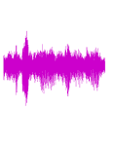
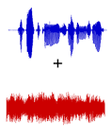
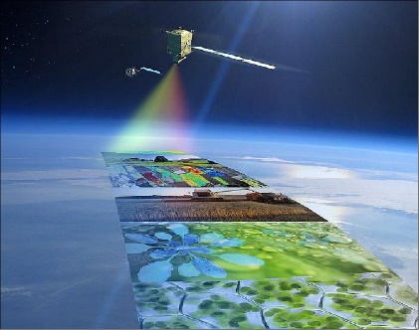
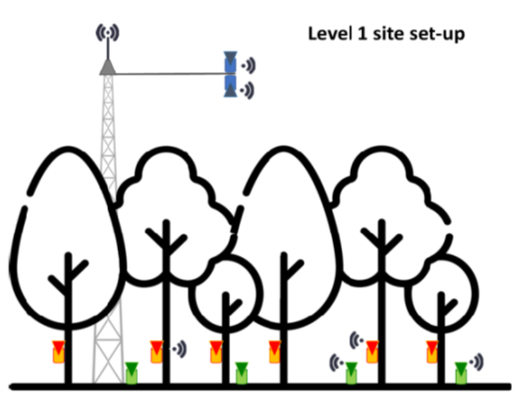
CNR-IBE SMA: Ecophysiological Remote Sensing
Research directions
new insights into interpretation of SIF and RS of SIF
to decouple the information carried by SIF from factors which challenge its full interpretation, such as counteracting physiological processes, as well as biochemical, structural and illumination effects
to join the efforts to ensure the cal/val of FLEX products essential to the quality of the mission
low-cost and easy maintenance systems to support EO
to contribute to the development of an cost-efficient IoT system for continuous in-situ monitoring of undersampled hard-to-reach forest areas
SCOOP
(PRIN 2022)
FLEX-ITA
(ASI)
RemoTrees (Horizon Europe)

Slide 4

Field campaign - summer 2024
Main research questions
Does SIF provide an added value for early detection of water stress compared to traditional reflectance and temperature-based RS methods?
What is the temporal sensitivity of the above-mentioned RS proxies to progressing soil water limitations?
What are the main factors (and what is their relative contribution) influencing TOC SIF and SIF-photosynthesis relationship under optimal and water stressed conditions?
Can the Photochemical Reflectance Index (PRI) or its modifications be considered a reliable RS proxy of NPQ?

Slide 5


Field campaign - summer 2024
Incident
PAR
Reflected PAR
Chlorophyll fluorescence
0.5-2%
Absorbed PAR
Photosynthesis
0-82%
Heat
18-98%
Image source: adapted from Garbulsky et al. (2014)

Slide 6
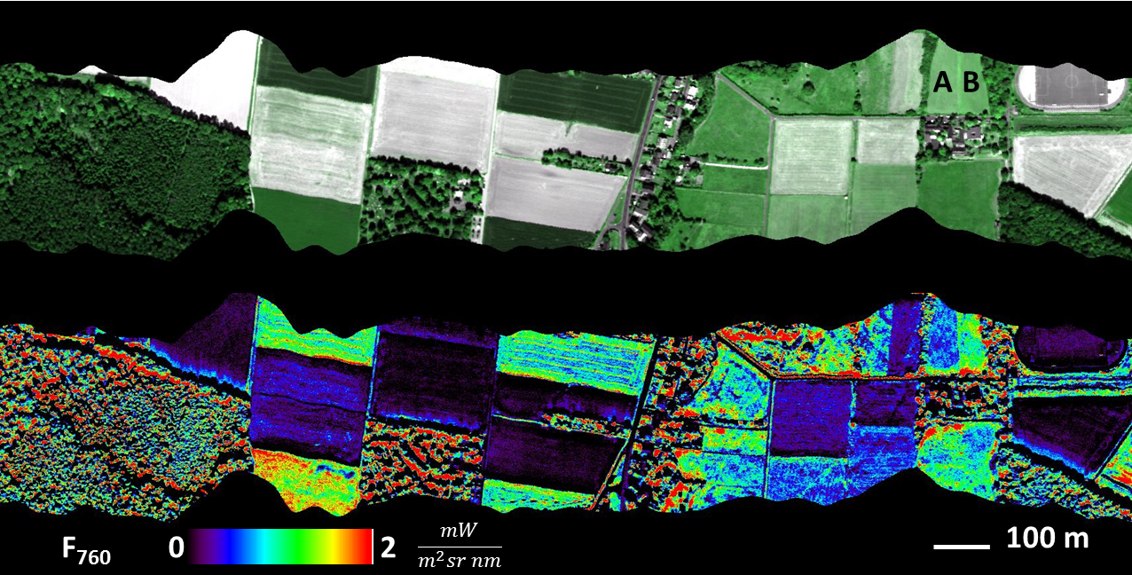
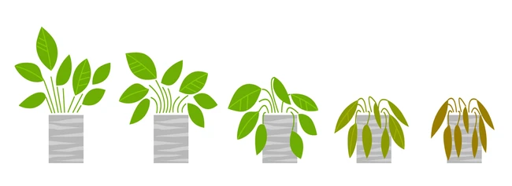

Field campaign - summer 2024
In contrary to traditional RS based on reflectance indices, SIF can be used to detect
sub-optimal conditions before significant reductions in Chl content or LAI have occurred.
Copyright: Forschungszentrum
Image source: https://www.fz-juelich.de/ibg/ibg-2/EN/Research/Projects/HYPER/hyper_projekt_node.html
The overall objective is to develop new
SIF-based indicators
for detection of early water stress.

Slide 7
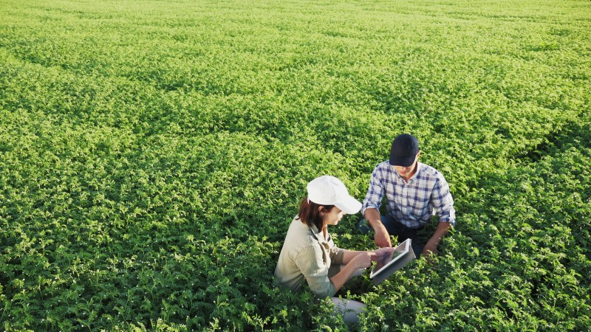
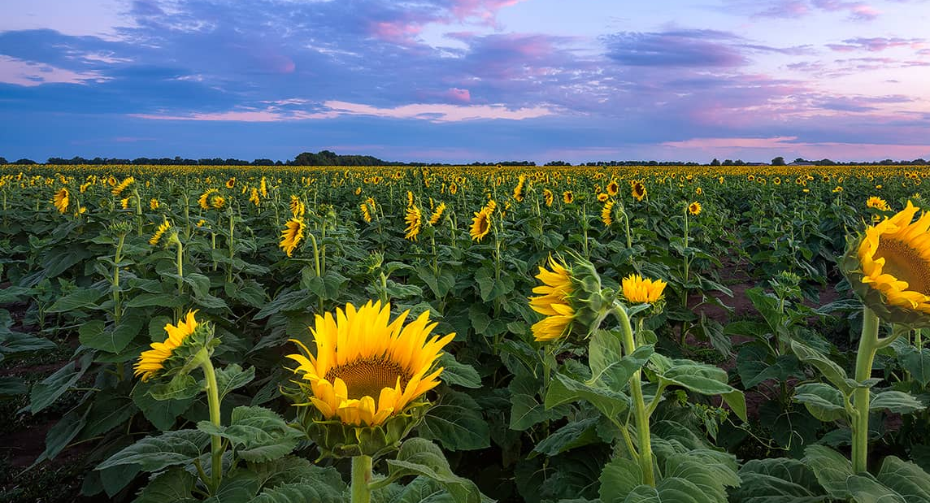
Field campaign - summer 2024
Crops:
1) chickpea (2 varieties):
Cicerone SIS - Società Italiana Sementi - Dettaglio Prodotti Cece CICERONE (sisonweb.com)
b) Vulcano (water stress resistant) SIS - Società Italiana Sementi - Dettaglio Prodotti Cece VULCANO (sisonweb.com)
2) sunflower (1 variety): Excelio Sy Excellio - Variety Girasole | Syngenta Italia
Structural and physiological factors are expected to be the main drivers of SIF in sunflower and chickpea, respectively, making them ideal contrasting species for a case study
to disentangle the causes of SIF variation.

Slide 8
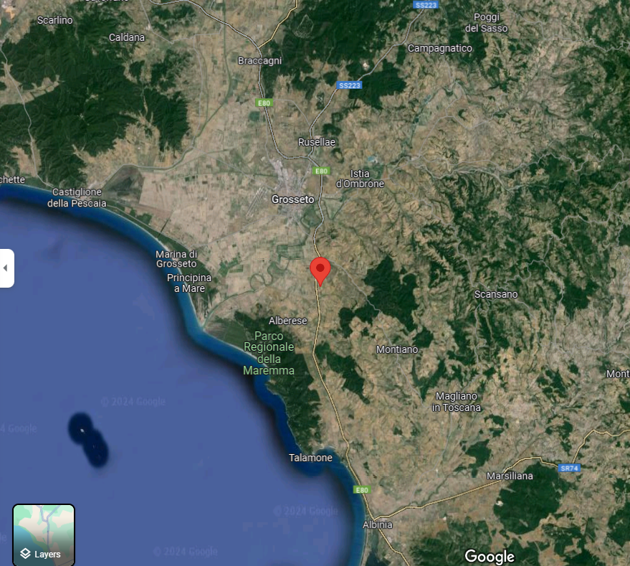
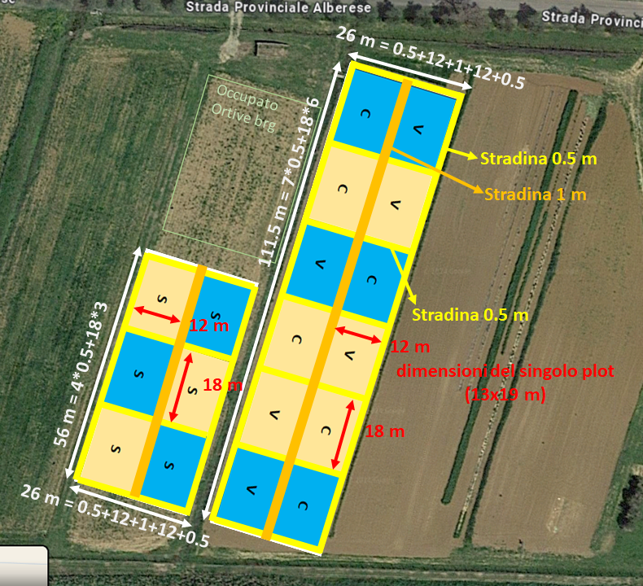
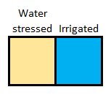
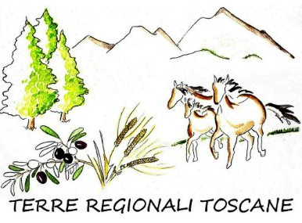
Field campaign - summer 2024
Plot scale experiment:
Chickpea Cicerone (C), Chickpea Vulcano (V), Sunflower Excelio (S)

Slide 9
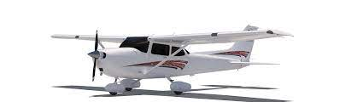




Field campaign - summer 2024
START
GROUND MEASUREMENTS
END
GROUND MEASUREMENTS
2-3 week period
(15 June – 7 July 2024)

Slide 10
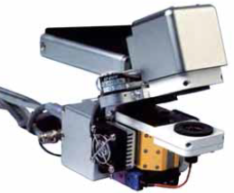
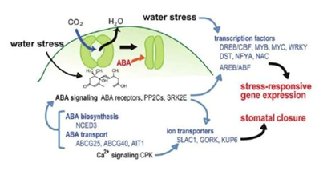
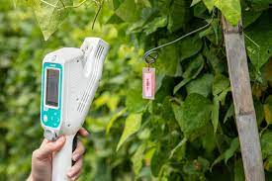
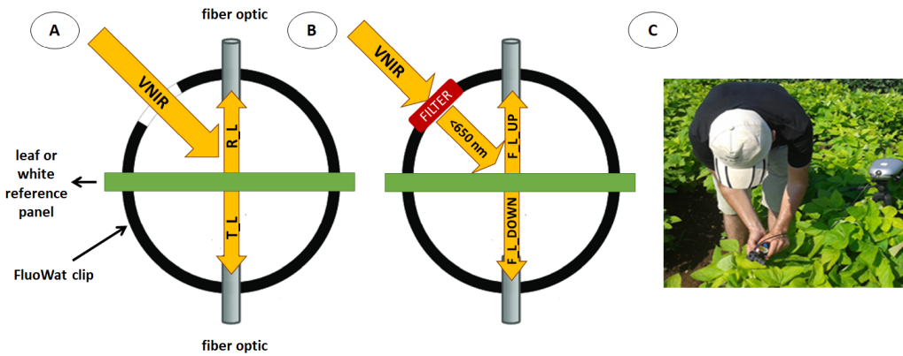
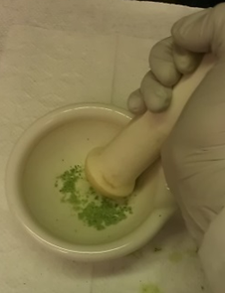
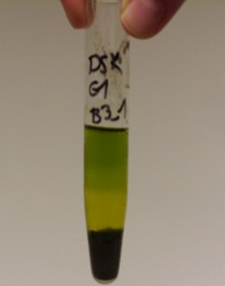
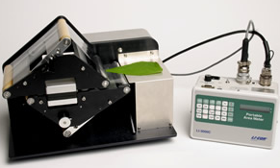
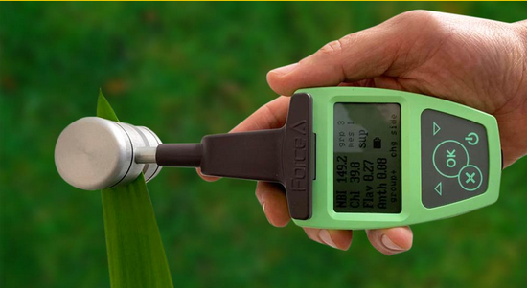
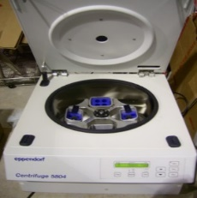
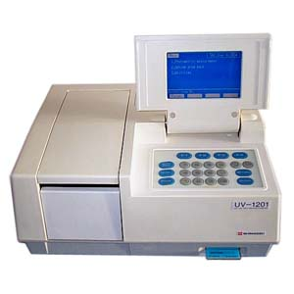
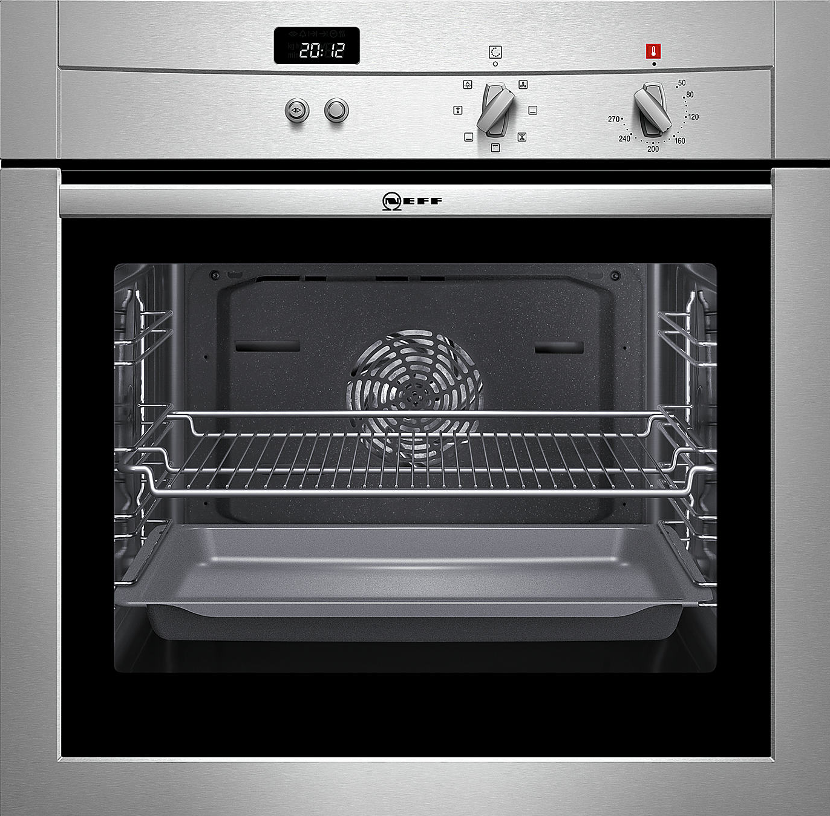
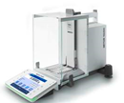
Field campaign - summer 2024
Stomatal conductance,
leaf water potential
Gas exchange and PAM fluorescence
(dark and light-adapted leaves)
ABA content
Trans, Refl, Abs and SIF
Pigment and water content
Specific leaf mass

Slide 11
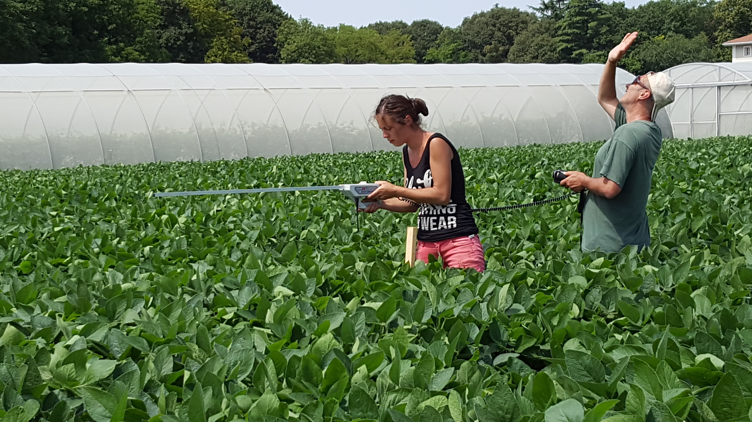
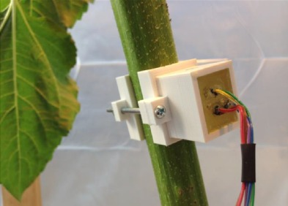
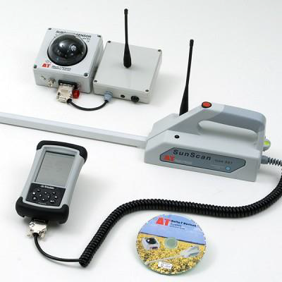
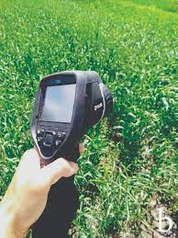
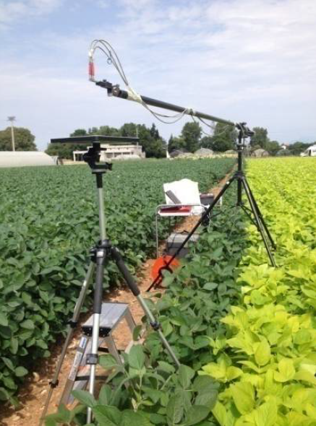
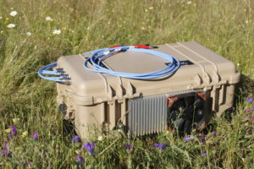
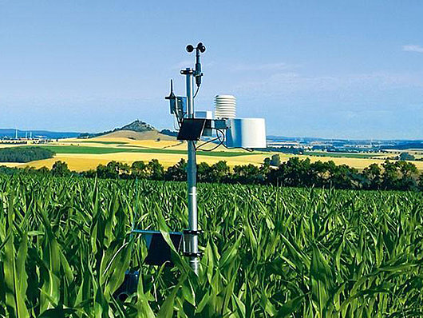
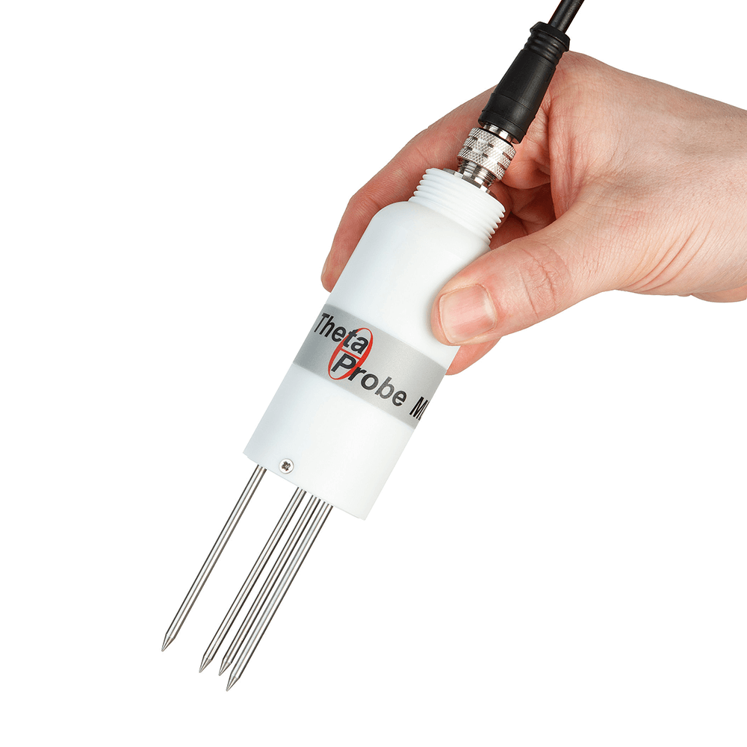
Field campaign - summer 2024
fAPAR
Canopy transpiration
Canopy temperature and leaf angle distribution
Hyperspectral reflectance and SIF
RH, Tair, Soil himudity

Slide 12
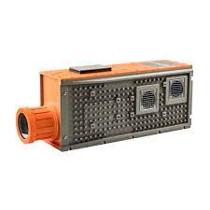
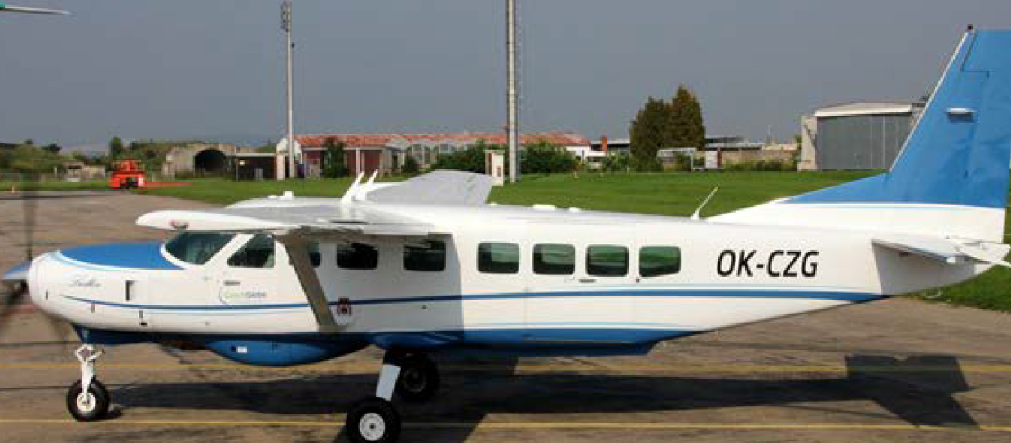
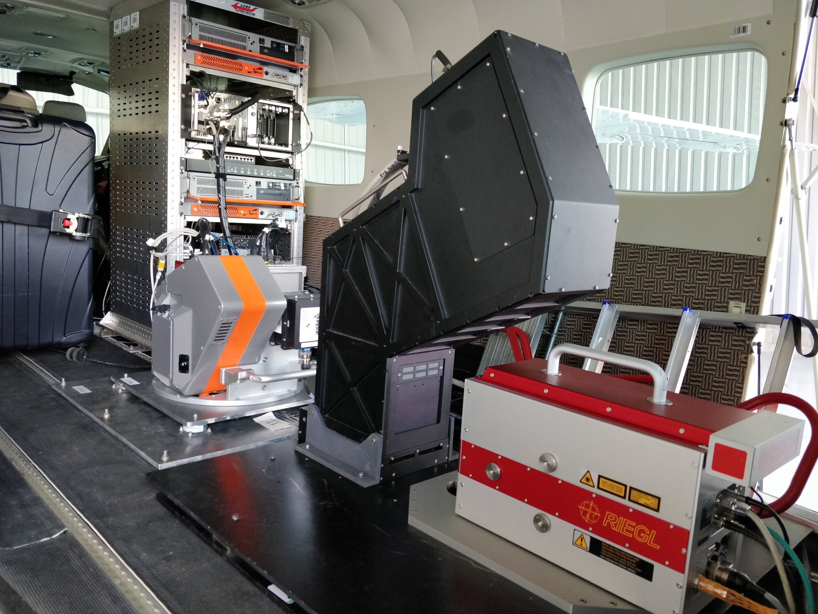


Field campaign - summer 2024
AisaIBIS Fluorescence imager (SIF)
Airborne RS sensing data:
full spectrum hyperspectral reflectance and SIF
(+ maybe thermal sensor)

Slide 13

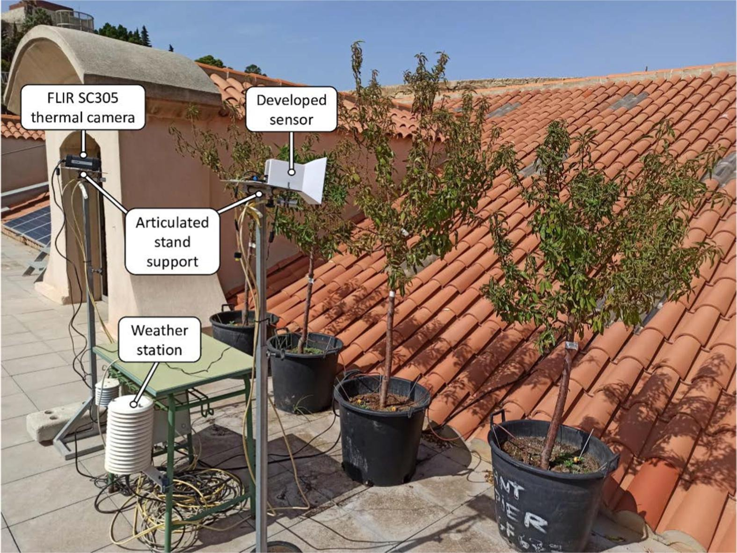
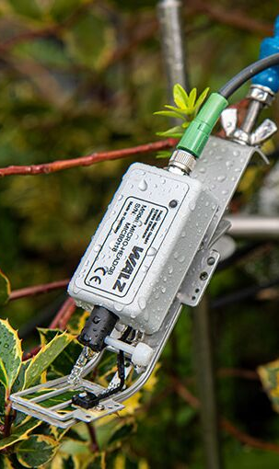
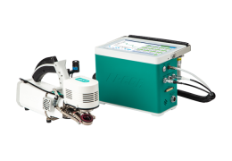
Field campaign - summer 2024
Crop Water Stress Index
Advices on most accurate weather forecasts (for flights and irrigation scheduling)
Leaf physiology measurements
https://doi.org/10.1016/j.compag.2021.106319
meteo station (RH, Tair)
ground-based sensors
for canopy temperature measurements
leaf physiology (gas exchange, PAM)

Slide 14







Field campaign - summer 2024
Karolina Sakowska
Federico Carotenuto
Franco Miglietta
Lorenzo Genesio
Francesca Ugolini
Mustafa Elfahl
Chiara Torresan
Silvia Baronti
Piero Toscano

