Slide 1
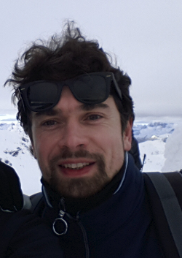

Ecologia Animale
Simone Tenan
Researcher

Slide 2
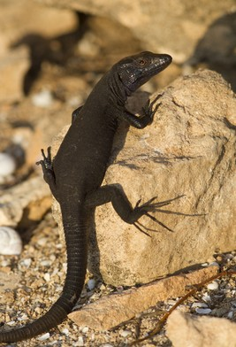
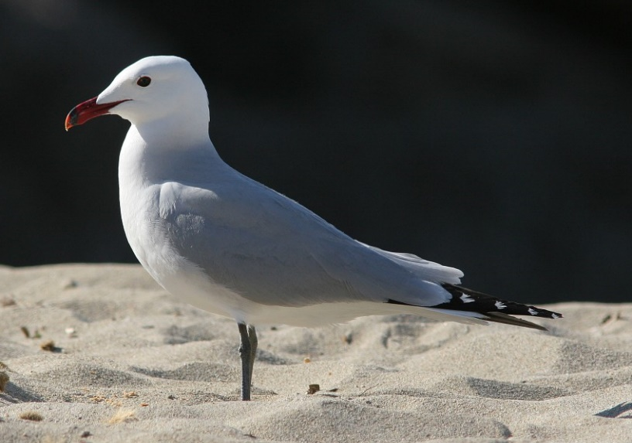
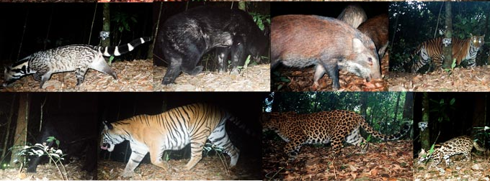
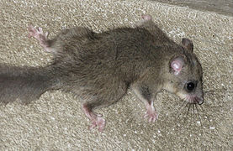
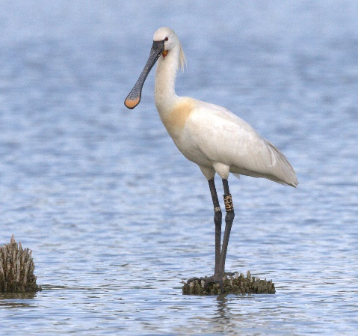
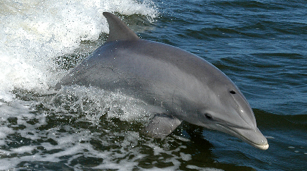
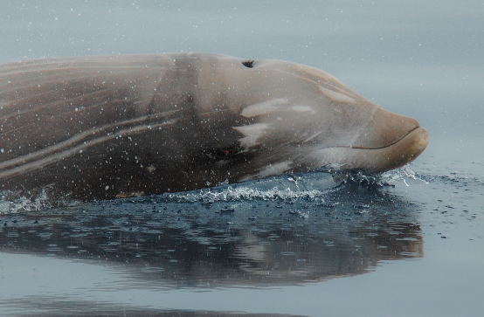
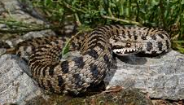
Ecologia Animale
spatio-temporal dynamics of populations and communities
applications for biodiversity conservation

Slide 3

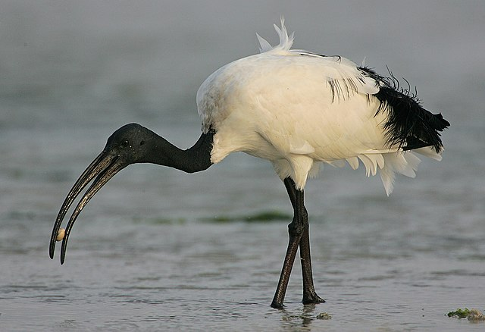

Ecologia animale
Main projects:
- Vital Rates of Cuvier’s beaked whales: A multi-regional
comparative assessment
- Population dynamics of waterbirds and seabirds in Italy

